Slide 1

Joel recently dropped out of college and needs a way to pay back his parents for the tuition they feel he “wasted”
Mamudu Bah

Slide 2

From a friend, Joel found out about Instacart and wants to pursue this job in hopes of a flexible schedule that works alongside his partying

Slide 3
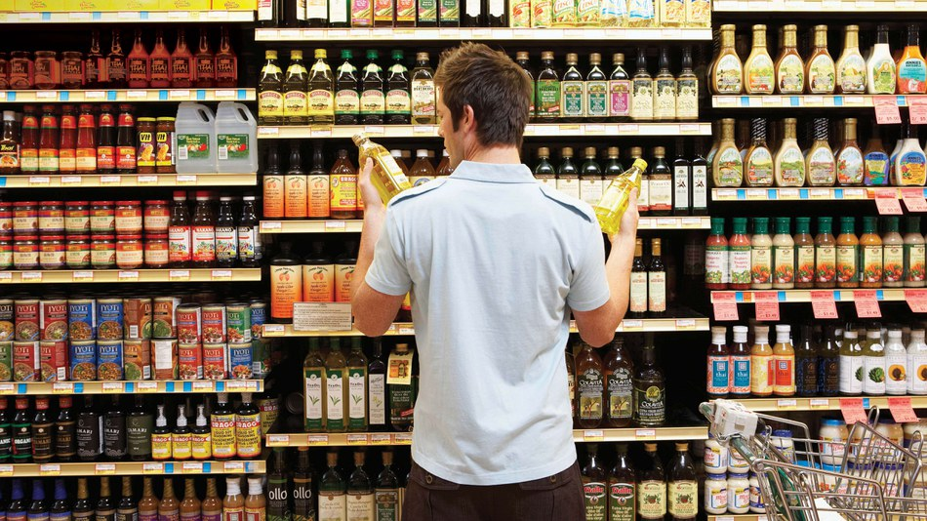
However, Joel quickly found that Instacart driving was much different than he had originally imagined. He knew he could make good many for the time off this job, but he didn’t know how to optimize his performance.

Slide 4
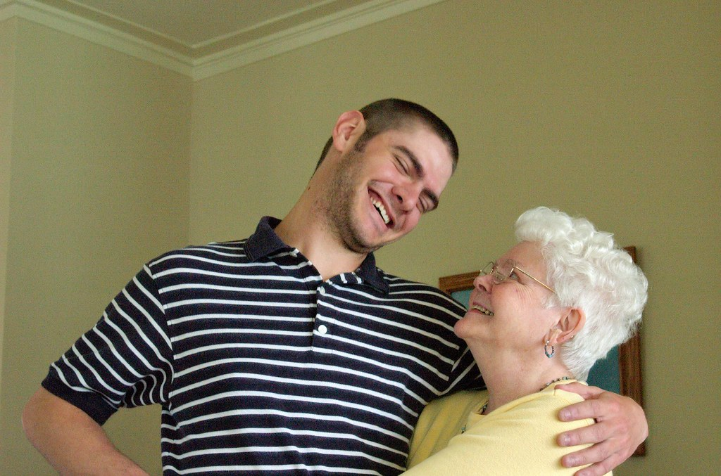
Joel’s mom saw an ad for an app called Grocery Blunder that she thought might help her son’s dilemma. After listening to Joel complain on the phone about his job for another entire call, she recommended the app in hopes for a better attitude from her son.

Slide 5
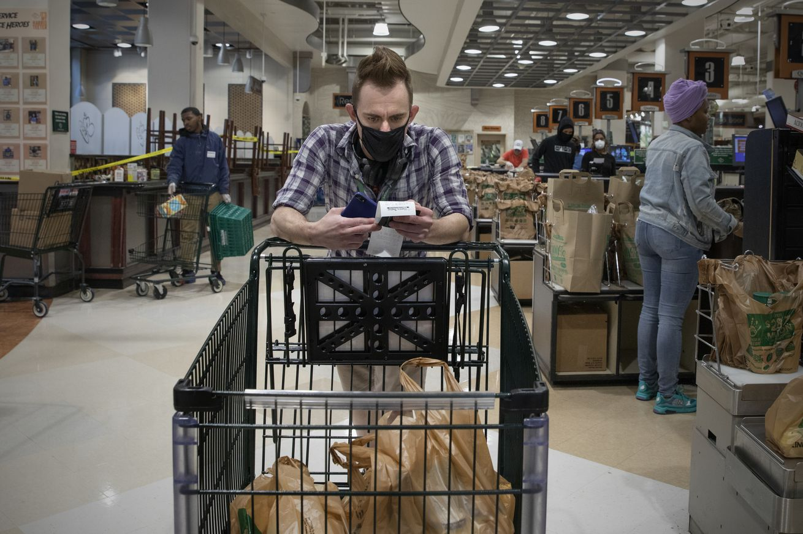
After nearly giving up on his recent dream of becoming a successful Instacart driver Joel decided to download Grocery Blunder and experiment with a short list he’d gotten with a far-off expectance time.

Slide 6

Joel found this shopping trip to be the easiest one he’d ever had before. He found everything without the typical back and forth across the store and saved so much time that the excess line length didn’t even affect his delivery time. He soon found that using the Grocery Blunder app was essential in being a successful Instacart driver. And finally, Joel made a payment towards the tuition he owed to his parents. 200$

